Slide 1

Infection Prevention and Control (IPAC) Training for Family and Visitors
家属與訪客訓練: 感染預防與控制
October 2023

Slide 2
Agenda
Active and Passive Surveillance 主動和被動篩查
Routine Practice日常練習
Hand Hygiene 手部衛生
Putting on and Taking off PPE 穿戴以及脫下個人防護裝備
Additional Precautions 額外的預防措施
Immunization 免疫接種
Outbreak Management 疫情管理
Cleaning and Disinfection 清潔和消毒
IPAC while Supporting Residents at Mealtime
協助長者用餐時的感染預防與控制要點
11. IPAC while Travelling to and from an LTC Home
往返護理院路途中的感染預防與控制要點

Slide 3
Active and Passive Surveillance
主動和被動篩查
Self-screen for symptoms of infection before entering the LTC home
進入長期護理中心之前自我篩查感染症狀
2. Stay home if you have signs and symptoms of infection
如果您有感染跡象和症狀，請留在家裡

Slide 4
Routine Practice
常規做法
Are used for all residents 用在所有院友
Includes risk assessment, risk reduction, and education 包括風險評估、風險降低和教育
Elements of Routine Practice
常規操作的要素
Risk Assessment 風險評估
Hand Hygiene 手部衛生
Barrier Equipment 保護設備
Environmental Controls 環境控制
Administrative Controls 行政控制

Slide 5
Risk Assessment
風險評估
A risk assessment must be done before each interaction with a resident/client
每次與院友/服務使用者互動之前必須進行風險評估
Risk assessment – what are you going to do
風險評估 -- 你將會做什麼
Risk reduction strategies - how to protect yourself
降低風險策略 -- 如何保護自己
Education – improving your knowledge to protect yourself and your clients
教育 -- 提高你的知識以保護你自己和院友/服務使用者

Slide 6
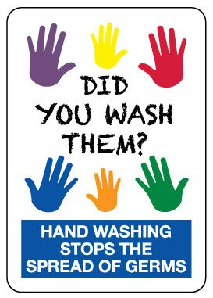
Hand Hygiene
手部衛生
Hand washing, done correctly, is an important personal hygiene practice to prevent the spread of communicable diseases. Many diseases can be spread easily by soiled hands or respiratory droplets. To stop the spread, just clean your Hands.
用正確的方法洗手是保持個人衞生的良好習慣，能有效地防止傳染病傳播。 如果雙手沾了髒污或呼吸道分泌物而沒有洗淨，便會很容易傳播疾病。要阻止傳播，記得清潔雙手。

Slide 7
When should we clean our hands?
我們應該在甚麼時候洗手？
Before preparing, handling, serving or eating food 在準備、處理、供應或食用食物之前
After using the washroom, blowing your nose, etc. 去洗手間後、擤鼻涕後等
Before putting on and after taking off gloves 戴手套前和脫手套後
Whenever you are in doubt about the necessity for doing so
當你對是否需要洗手有疑問時
In addition to the above indications for hand hygiene, there are some essential moments in health care settings where the risk of transmission is greatest and hand hygiene must be performed: Your 4 Moments of Hand Hygiene.
除了上述需要清潔雙手的時刻外，在醫療保健環境中還有一些重要時刻，傳播風險最大，必須進行手部清潔: 清潔雙手四時刻
4 Moments of Hand Hygiene (English video): https://www.youtube.com/watch?v=mcSi1a9pIdk

Slide 8
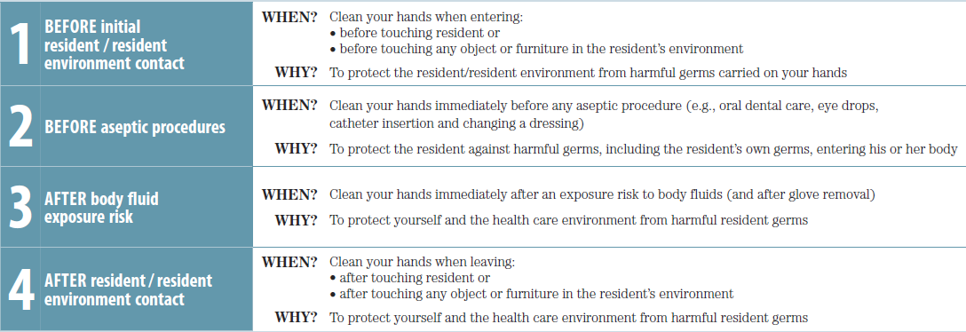
When should we clean our hands?
我們應該在甚麼時候洗手？

Slide 9
When should we clean our hands?
我們應該在甚麼時候洗手？
1. 在接觸長者或長者附近的環境前 | 什麼時候？ 為什麼？ | 進入時請清潔雙手： • 在接觸院友之前或 • 在接觸院友環境中的任何物體或家具之前 保護院友/院友環境免受手上攜帶的有害細菌的侵害
2. 無菌操作前 | 什麼時候？ 為什麼？ | 在進行任何無菌操作（例如口腔牙科護理、滴眼液、導管插入和更換敷料） 保護院友免受有害細菌的侵害，包括院友自身的細菌，進入他或她的身體
3. 有接觸到體液的風險後 | 什麼時候？ 為什麼？ | 有接觸到體液的風險後立即洗手（以及脫下手套後） 保護您自己和醫療保健環境免受有害細菌的侵害
4. 在接觸長者或長者附近的環境後 | 什麼時候？ 為什麼？ | 離開時清潔雙手： • 在接觸院友或 • 在接觸院友環境中的任何物體或家具後 保護您自己和醫療保健環境免受有害細菌的侵害

Slide 10
Hand Hygiene and Glove Use
清潔雙手與使用手套
The use of gloves does not replace the need to clean hands.
使用手套並不能代替清潔雙手。
Discard gloves after each procedure and clean your hands.
每次相關程序結束後應丟棄手套並清潔雙手。
Wear gloves only when indicated, otherwise they become a major risk for transmission of organisms. 僅在按指示有需要時才戴手套，否則它們會成為生物傳播的主要風險。

Slide 11
Two Ways to Clean Hands
兩種清潔雙手的方式
Liquid Soap and Running Water
用洗手液及流水洗手
Hand Sanitizer
消毒洗手液
用洗手液徹底洗手最少十五秒，能有效防止感染及傳播傳染病。
Washing hands thoroughly with liquid soap for at least 15 seconds can effectively prevent contracting and spreading communicable diseases.
如雙手沒有明顯污垢時，可用含至少70%酒精的消毒洗手液清潔雙手。
If your hands are not visibly soiled, you can use an alcohol-based hand sanitizer that contains at least 70% alcohol. You can tell if the sanitizer contains at least 70% alcohol by looking at the product label.

Slide 12
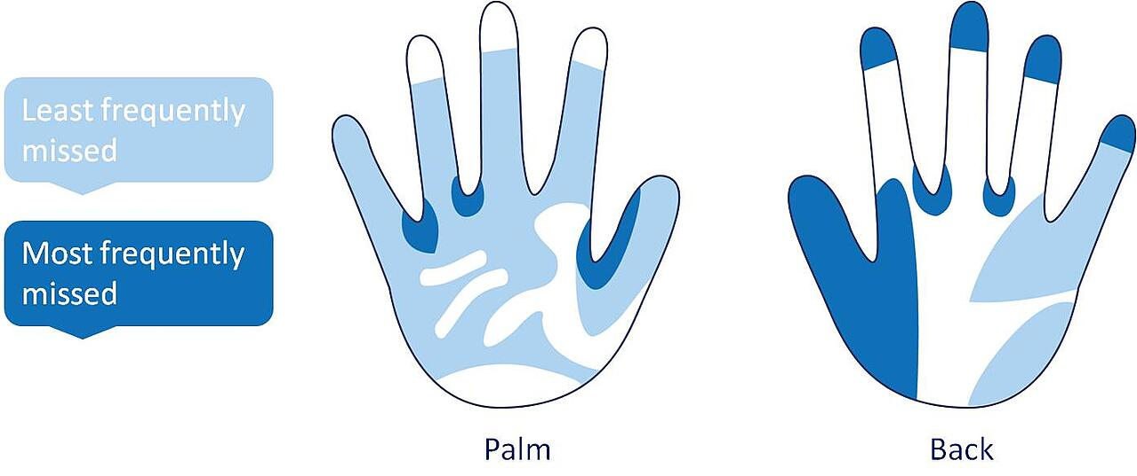
How to Clean Your Hands
清潔雙手方法
Clean your hands with soap or alcohol hand rub to cover all aspects of hands
仔細清潔雙手每部份
最不常被忽略的
最常被忽略的

Slide 13
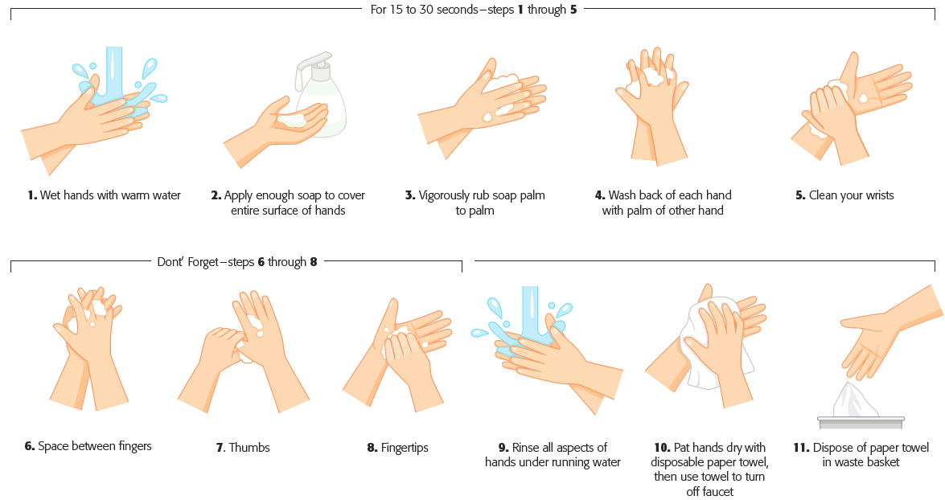

Slide 14
How to Hand Wash
如何用洗手液及流水洗手
Japanese video: 正しい手洗いの方法 解説動画
Video with subtitles in English & Chinese 中英文字幕影片: https://www.youtube.com/watch?v=gT-EfuVNOls
Notes:
かなチャンTV（神奈川県公式）. “正しい手洗いの方法 解説動画.” YouTube, 1 Aug. 2019, youtu.be/F1b5pInPkP0?si=lE0MmXtvEQAfTp2m. Accessed 12 June 2024.

Slide 15
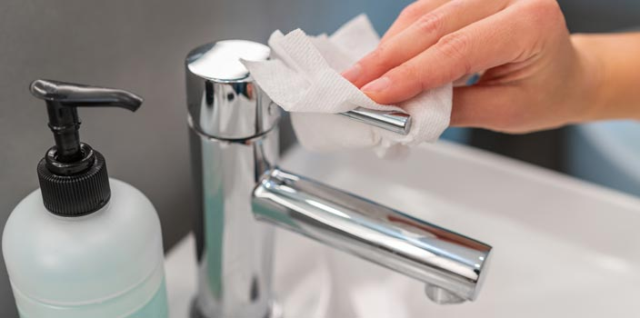
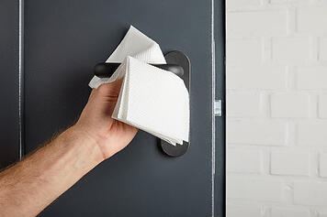
Use a paper towel to turn off the tap
雙手洗乾淨後，不要再直接觸摸水龍頭
Use a paper towel to grab the door handle
雙手洗乾淨後，不要再直接開門

Slide 16
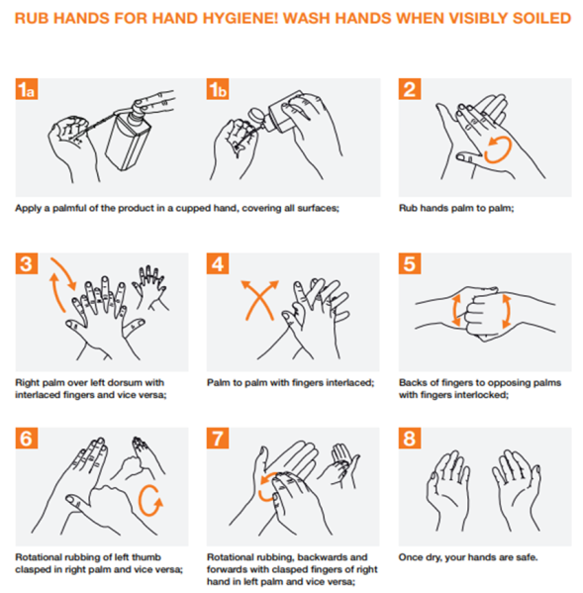
How to Hand Rub
如何用酒精搓手液清潔雙手
The right way to use Hand Sanitizer
酒精搓手液的正確使用方法:
Apply the product to the palm of one hand (read the label to learn the correct amount). 將酒精搓手液塗抹在一隻手的手掌上（閱讀標籤了解正確的用量）。
Rub your hands together. 雙手互相揉搓
Rub the product over all the surfaces of your hands and fingers until your hands are dry. This should take at least 15 seconds. 將酒精搓手液揉搓在手和手指的所有表面上至變乾。 這應該需要至少 十五 秒。
English Video: https://www.youtube.com/watch?v=sDUJ4CAYhpA

Slide 17
Don’t Forget the Residents!
別忘了院友們的手部衛生
Assist/remind them to wash hands:
  after toileting
  before meals and activities
  after visiting someone who is sick
  after blowing their nose, coughing or sneezing
  after touching a pet
協助/提醒他們洗手:
  上廁所後
  飯前和活動前
  拜訪生病的人後
  擤鼻涕、咳嗽或打噴嚏後
  觸摸寵物後

Slide 18
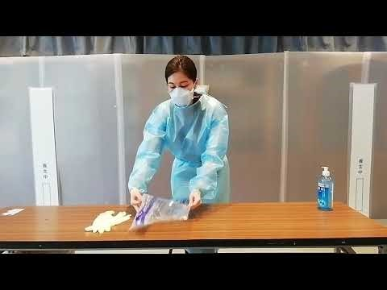
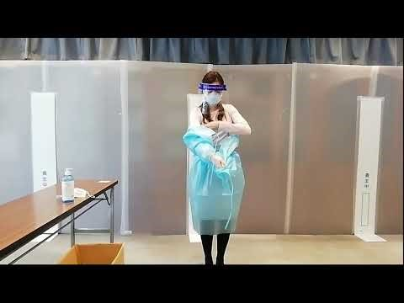
Putting on and taking off PPE
穿戴以及脫下個人防護裝備
Putting on PPE
Taking off PPE
Notes:
かなチャンTV（神奈川県公式）. “個人防護具（PPE）脱衣手順（神奈川県版）.” YouTube, 30 Apr. 2021, youtu.be/JnV05pNIW8U?si=WkbNvVMlrHMwwf2y. Accessed 12 June 2024.
かなチャンTV（神奈川県公式）. “個人防護具（PPE）着用手順（神奈川県版）.” YouTube, 30 Apr. 2021, youtu.be/pLN0leRB5nU?si=YDL9XzZrdKR-aYNK. Accessed 12 June 2024.

Slide 19
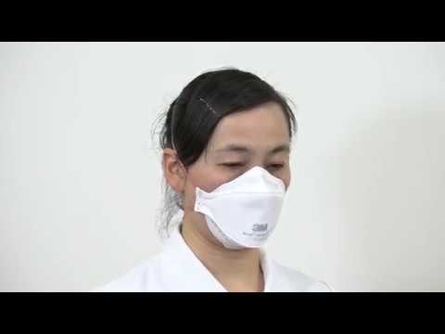
How to wear a medical & N95 mask
如何佩戴醫用口罩/N95口罩
マスクの使い方・はずし方 ３Ｍ Aura N95微粒子用マスク（医療用）1870＋
Notes:
フィットテスト研究会. “７）マスクの使い方・はずし方 ３Ｍ Aura N95微粒子用マスク（医療用）1870＋.” YouTube, 29 May 2017, youtu.be/6WVc2sWojyw?si=Ed4CXuLVfji8XVk-. Accessed 12 June 2024.

Slide 20
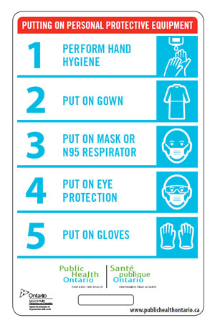
Steps of Putting on P.P.E.
穿戴個人防護裝備的步驟
Put on PPE in the following order
1. Perform hand hygiene! 清潔雙手！
2. Gown 保護袍
3. Mask 口罩
4. Goggles/face shield 眼罩/面罩
5. Gloves 手套

Slide 21
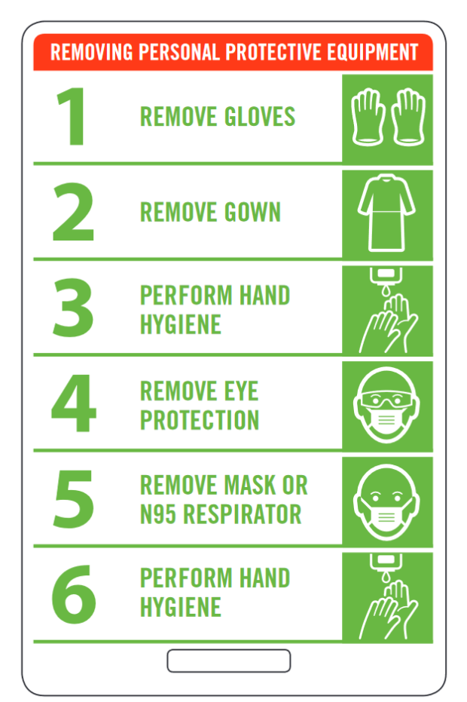
Steps of Taking off P.P.E.
脫除個人防護裝備的步驟
Take off PPE in the following order
1. Gloves 手套
2. Gown 保護袍
3. Perform hand hygiene! 清潔雙手！
4. Goggles/face shield 眼罩/面罩
5. Mask 口罩
6. Perform hand hygiene! 清潔雙手！

Slide 22
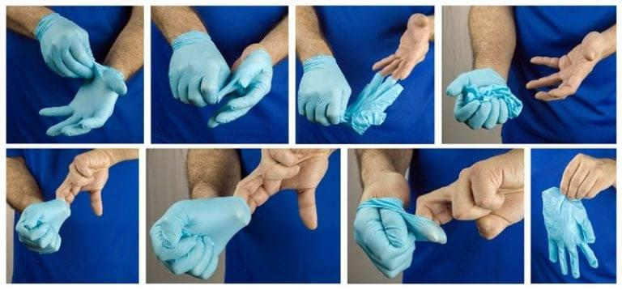
Remove Gloves
脫除手套
Remember: gloves to gloves, skin to skin
1
2
3
4
5
6
7
8
Videos 影片:
Taking off gloves 脫除手套: https://youtu.be/WDl0Zj573Js

Slide 23
Additional Precautions
額外的預防措施
Are used in addition to Routine Practices to protect staff and residents from transmission of known or suspected infectious agents
在常規做法的同時，用於保護工作人員和院友免受已知或可疑傳染源的傳播
Contact precaution 接觸預防
Droplet precaution 飛沫預防
Droplet/Contact precaution 飛沫/接觸預防
Airborne precaution 空氣預防

Slide 24
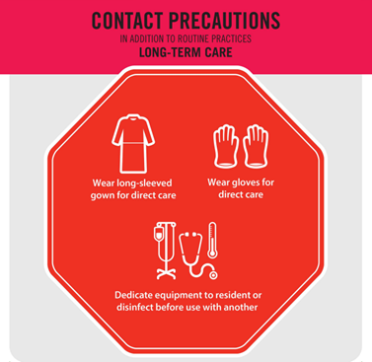
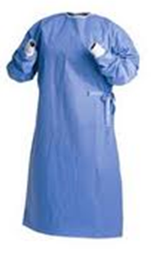
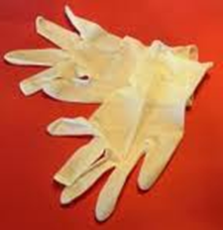
Contact precaution
接觸預防
Gown and gloves for contact with resident (direct) or environment of care (indirect)
接觸院友(直接) 或護理環境(間接) 用長袍和手套

Slide 25
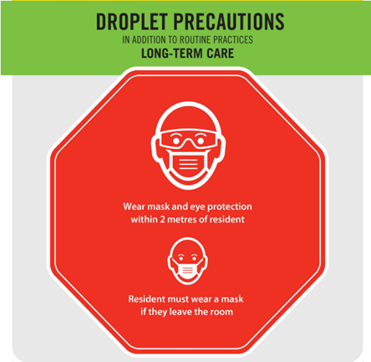
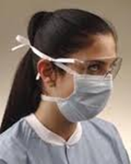
Droplet precaution
飛沫預防
Surgical masks and eye protection i.e. goggles/face shield/ visors attached to masks within 2 meter of a coughing resident 外科口罩和護目鏡。例如，在咳嗽院友 2 米範圍內佩戴護目鏡/面罩/带面罩的口罩

Slide 26
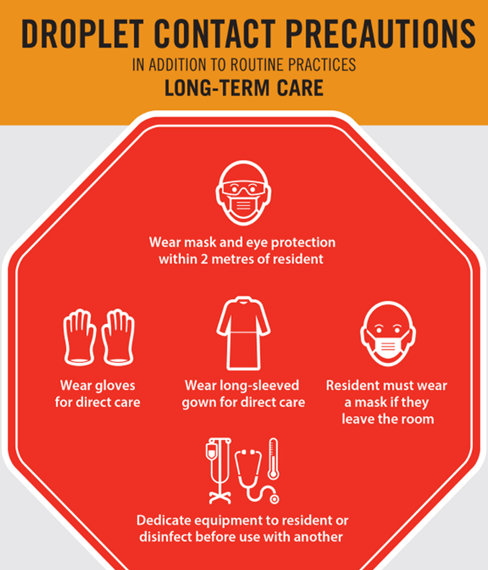
Droplet/Contact precaution
飛沫/接觸預防
Surgical masks and eye protection within 2 meter of a coughing resident or procedures with a potential for splashes or sprays of body fluids to the eyes, gown and gloves
距離咳嗽院友 2 米範圍內或進行可能導致體液飛濺或噴灑到眼睛的操作、带外科口罩和護目鏡，防護服和手套

Slide 27
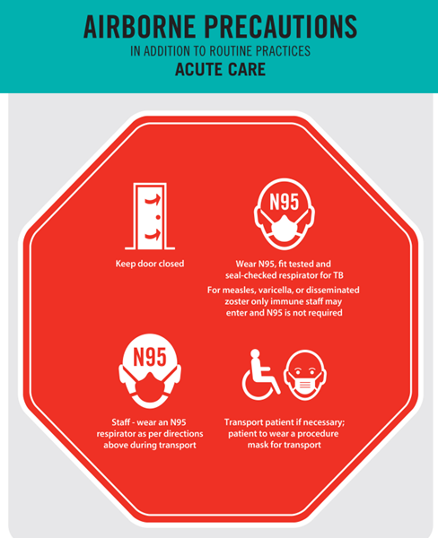
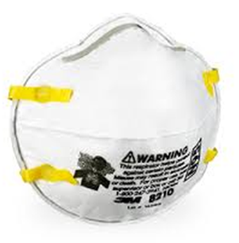
Airborne precaution
空氣預防
Particulate respirator (N95 mask) 顆粒物呼吸器 (N95口罩)
Negative pressure room 負壓室

Slide 28
Elements of Additional Precaution
額外的預防措施的要素
Specialized Accommodation and Signage 專門的措施和標牌
Barrier Equipment 屏障設備
Dedicated Equipment 專用設備
Additional Cleaning Measures 額外的清潔措施
Communication 溝通

Slide 29
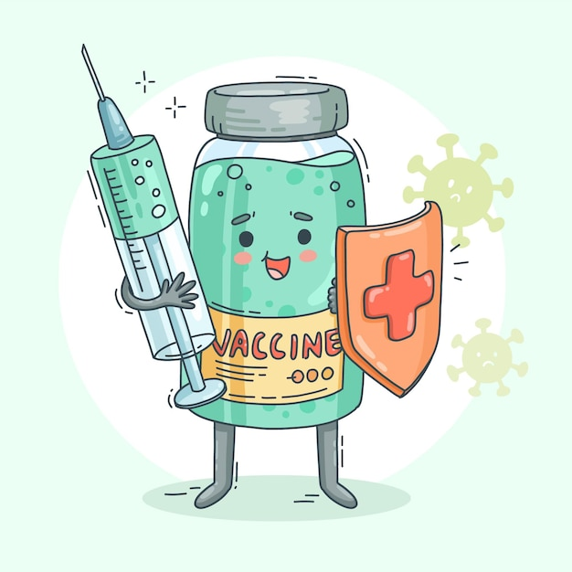
Immunization
免疫接種
Stay up to date with your vaccines 及時接種疫苗:
Influenza Immunization 流感疫苗接種
COVID-19 Immunization 新冠肺炎疫苗接種

Slide 30
Outbreak Management Team (OMT)
疫情管理團隊
Executive Director 執行董事
Director of Resident Care 護理主任
IPAC Manager and IPAC Lead 感染預防和控制經理/負責人
Assistant Director of Resident Care 助理護理主任
Charge Nurse of the outbreak unit/floor 病房/樓層主管護士
PSW(s) of the outbreak unit/floor 護理員
Food Services Manager/Supervisor 餐飲服務經理/主管
Facility Manager 設施經理
Activation Manager 活動部經理
Medical Director 醫療主任
Local Public Health Liaison 當地公共衛生聯絡員
Other internal member/external parties as needed 其他內部成員/外部各方（根據需要）

Slide 31

Outbreak Control Measures
疫情控制措施
Follow Public Health guidelines for visiting outbreak units/floors
根据衛生局的探訪指示前往疫情爆發的單位/樓層
Self-monitor for signs of illness and do not enter the home if unwell
自我監測是否有疾病跡象，如有不適請勿進入院内
Hand Hygiene 手部衛生
Resident group activities may be stopped
院友團體活動可能會停止
Staff cohorted 調整員工工作單位

Slide 32
Reminder ! 請注意！
Follow these simple steps to protect yourself:
請遵循以下簡單步驟來保護自己：
Wash your hands 洗手
Cover your cough and sneeze 咳嗽和打噴嚏時遮住口鼻
Avoid touching your eyes, nose or mouth 避免觸摸眼睛、鼻子或嘴巴
Avoid close contact with persons who are sick 避免與病人密切接觸
Stay home when you are sick 生病時留在家中
Stay well rested 保持良好的休息
Be physically active 保持身體活躍
Drink plenty of fluids 多喝水
Eat nutritious food 吃有營養的食物

Slide 33

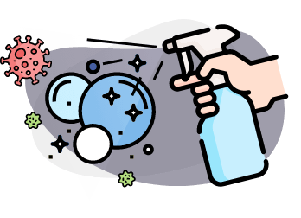
Cleaning and Disinfection Program
清潔和消毒計劃
To prevent the transmission of infection to residents and/or health care workers by providing assurance of proper equipment/environmental surfaces cleaning, disinfection and sterilization
通過確保適當的設備/環境表面清潔、消毒和滅菌，防止感染傳播給院友和/或醫護人員
Use facility approved products
使用院内批准的產品
Cleaning and disinfecting is a two-step process
清潔和消毒是兩步過程

Slide 34

IPAC while supporting residents at mealtime
協助長者用餐時的感染預防與控制要點
Perform hand hygiene before you come into the environment of the resident (table, room, etc.) 在您進入長者的環境（餐桌、房間等）之前，先對雙手進行清潔
The resident should also perform hand hygiene before having a meal
長者用餐前亦應清潔雙手
Perform hand hygiene after you finish assisting a resident
在完成對這位長者的服務之後要洗手
If your mask is visibly soiled, change to a new one
若您的口罩在此過程中變髒了，請更換新的

Slide 35
How about your mealtime with resident?
如果和長者在中心內用餐
Check with staff where you can have lunch (tea room)
與職員確認您可以在哪裡午餐（茶室）
In tea room or staff lounge, disinfectant (wipes/liquid) and paper towel are provided. Please disinfect your table before and after meal.
在茶室或員工休息室，會有消毒(巾/液體)和紙巾。請在餐前餐後對餐桌進行消毒。
Perform hand hygiene before having a meal 餐前請清潔雙手
How to place your mask during your meal? 用餐時如何放置口罩？

Slide 36
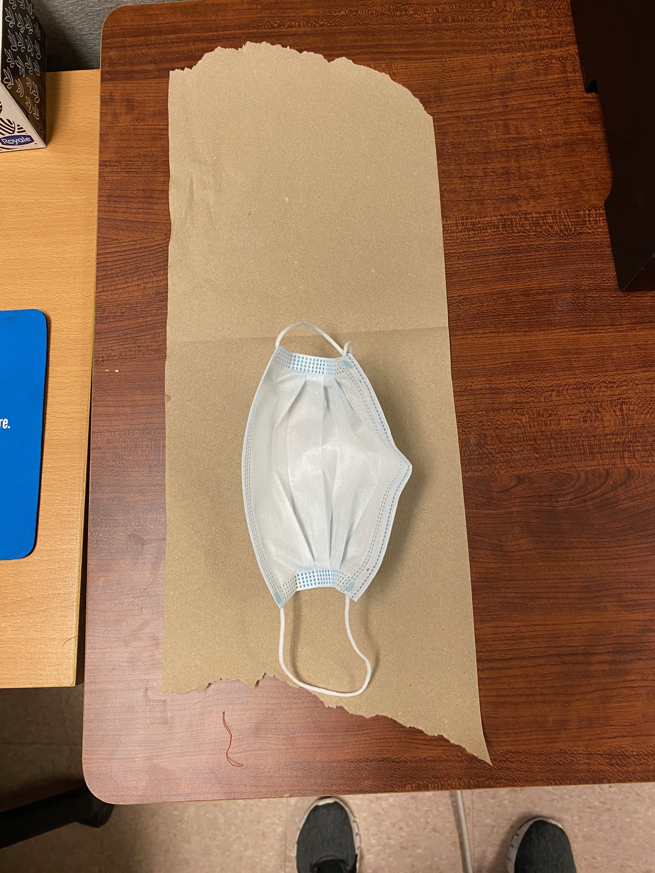
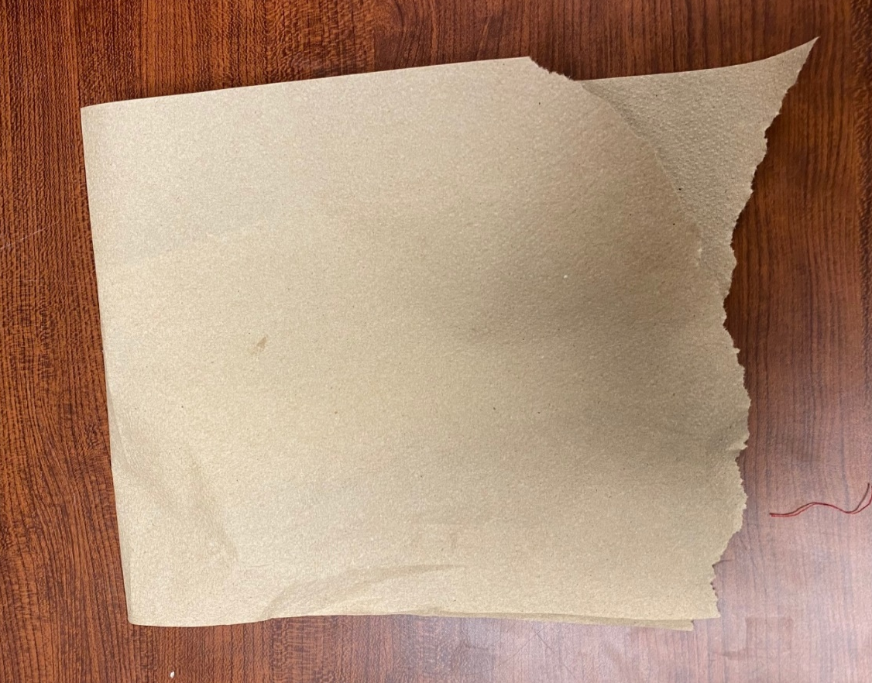
How to place your mask during your meal?
用餐時如何放置口罩？
After sanitizing the table and performing hand hygiene, place a paper towel on the table
在消毒餐桌及雙手後，將紙巾放在餐桌上
Carefully remove your mask by handling the mask from the ear loops only, place it on the paper towel, with the outside surface facing down, inside surface facing up
僅拿住繞耳的橡筋，小心地取下口罩並放在紙巾上，口罩的外表面朝下，內表面朝上
Cover the mask with another paper towel 用另一張紙巾蓋住口罩

Slide 37

IPAC while travelling to and from an LTC home
往返護理院路途中的感染預防與控制要點
Travelling by public transit or by car pooling
乘坐公共交通工具或汽車共乘/拼車
* If you have symptoms such as fever or worsen cough, stay home, and do not take public transit or car pool
如有發燒或咳嗽加重等症狀，請留在家中，請勿乘坐公共交通工具或汽車共乘/拼車
1. Recommend wearing a mask properly throughout the ride 建議在整個旅程中佩戴好口罩
2. After touching surfaces that you think may be contaminated, please wash/sanitize your hands immediately if possible 在接觸過可能被污染的表面後，請盡量立即清潔雙手
3. Always wash/sanitize your hands before you touch your mask , eyes, nose or mouth
在接觸口罩、眼睛、鼻子或嘴巴之前，請記得先清潔雙手
4. If possible, keep some distance between you and other people 盡量與其他人保持一定的距離

Slide 38
IPAC while travelling to and from an LTC home
往返護理院路途中的感染預防與控制要點
Travelling by public transit or by car pooling
乘坐公共交通工具或汽車共乘/拼車
If possible, you could increase ventilation by opening a window
如有可能，您可以通過打開窗戶來增加通風
7. Avoid eating and drinking when you are taking public transit or car pooling
乘坐公共交通工具或汽車共乘/拼車期間應避免飲食
8. Wash/sanitize your hands thoroughly when you enter our locations or enter your home.
在進入我們的中心時，或回到自己家中時，都應清潔雙手。
9. Regularly clean/sanitize the items that you need to touch often: phone, keys, presto card, etc.
定期清潔/消毒您需要經常接觸的物品，如電話、鑰匙、交通卡等。

Slide 39
Thank you for attending this training!
感謝您參加本次訓練!

