Slide 1

Privacy Overview

Slide 2
It’s the Law!
In Ontario,
Personal Health Information Protection Act (PHIPA)
Set out rules for the collection, handling, and disclosure of personal health information.
Apply equally to organizations (i.e., hospitals, LTC homes, medical clinics) AND individuals (i.e., physicians, nurses …etc.).
Both “you” AND Yee Hong are liable for any privacy breach
2

Slide 3
Our Commitment to Privacy
We respect the privacy of our clients, staff, volunteers, and our partners.
We are committed to keeping personal and personal health information in our possession safe and confidential.
To ensure that staff, students, and volunteers understand how to protect personal information, Yee Hong has a comprehensive set of Privacy Policies.
3
Notes:
3

Slide 4
Yee Hong Privacy Policies
CAD-VI-01 Privacy – General
CAD-VI-02 Privacy – Confidentiality
CAD-VI-03 Privacy – Complaint Process
CAD-VI-05 Privacy – Responding to Privacy/Confidentiality Breach
CAD-VI-06 Privacy – Capturing and Use of Personally Identifiable Photographic Images
CAD-VI-07 Privacy – Security Audit – Resident Personal/Health and Corporate Information
CAD-VI-08 Privacy – Consent Management
CAD-VI-09 Privacy – Client Privacy Rights Support Process
CAD-VI-10 Privacy – Incident Management (Integrated Assessment Record)
CAD-VI-11 Privacy – Security Audit – IAR Log Review
CAD-VI-13 Privacy – IAR User Training
4
Notes:
4

Slide 5
Yee Hong Privacy Framework
Key Features:
Rules for accessing, collecting, using, disclosing, and retaining personal and personal health information
Based on 10 principles
Accountability
Identifying Purposes
Consent
Limiting Collection
Limiting Use, Disclosure and Retention
  Accuracy
  Security
  Openness
  Individual Access
  Challenging Compliance
5
Notes:
5

Slide 6
Proprietary Information
Information Type | Examples
Personal Health Information | Physical and mental health including family health history Health care services received Payments or eligibility for health care Donation of any body part or substance Health number Identity of substitute decision maker
Personal Information | Name, address, contact information
Confidential Corporate Information | Salaries and benefits Employee records Budgets, business plans Non-public information contained in corporate documents
6
Notes:
6

Slide 7
Consent
Elements of Consent | Key Points to Remember
Must be a consent of the individual Must be knowledgeable Must relate to the information Must NOT be obtained through deception or coercion | Can be withdrawn or withheld at any time Can be conditional and limited Can be verbal or written Consent must be recorded in the client chart Yee Hong must respect clients’/residents’ decisions related to consent
7
Notes:
7

Slide 8
Consent
Implied | Expressed
Consent is implied within a client’s circle of care (individuals responsible for providing care to the client/resident) to maintain the flow of information necessary to provide care Clients can refuse, withdraw, or limit consent at any time | Expressed consent is required for collection, use, handling or disclosure outside the circle of care A consent directive is the direction provided by a client/resident as to how PHI is to be shared
If consent was not provided and PHI is collected, used, handled or disclosed to unauthorized individuals, a PRIVACY BREACH has occurred.
8

Slide 9
Privacy Breach Process
Privacy Breach occurs when proprietary information is stolen, lost, used or disclosed without consent or authorization
Proprietary information includes:
  personal health information
  personal information
  confidential corporate information
Report to your immediate supervisor ASAP
CAD-VI-05 Privacy – Responding to Privacy/ Confidentiality Breach defines the investigation and reporting procedures
9
Notes:
9

Slide 10
Implications of a Privacy Breach
Reporting
  Corporate Privacy Officer, senior management
  Information and Privacy Commissioner (IPC)
  Professional college (if disciplinary actions taken)
Notify impacted individual(s)
  individual has the right to complain to the IPC
Corrective and/or Disciplinary Actions
  Implement corrective actions to prevent future happenings
  disciplinary actions may be taken if determined to be a willful breach
Possibility of Prosecution
  IPC has the right to investigate and take legal actions with all reported breaches
10
Notes:
10

Slide 11
What is Information Security?
Information security is the practice of preventing unauthorized access, use, disclosure, disruption, modification, inspection, recording or destruction of information, regardless of the form the data may take (e.g., electronic, physical).
At Yee Hong, we treat Information Security seriously. We are the custodians of the information of our residents and clients. Whether the info resides on email or an electronic document, on a laptop, on a storage device, on paper, in a file, etc. it is our responsibility to uphold its confidentiality, integrity and availability.
11

Slide 12
Why should we care?
Among the top reasons are:
  Data leaked may cause harm to our clients, residents, volunteers or employees
  Data leaked may result in financial loss for Yee Hong
  Could seriously compromise the public trust in Yee Hong
  Could result in regulatory non-compliance
  Recovering from a data breach is expensive and not guaranteed
12

Slide 13
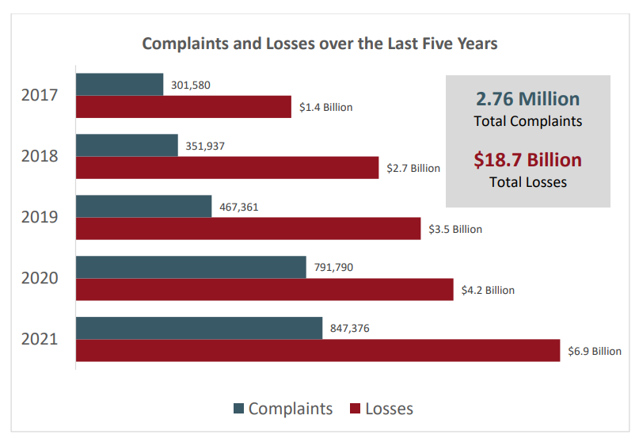
IC3 Complaint Statistics*
* FBI Internet Crime Report 2021
13

Slide 14
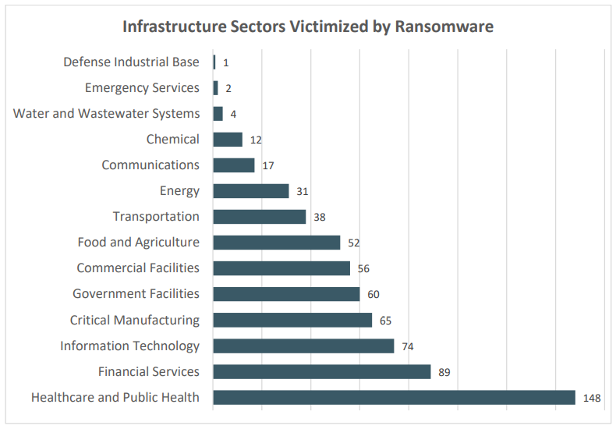
Ransomware and Critical Infrastructure Sectors*
* FBI Internet Crime Report 2021
14

Slide 15
Common Causes of Data Breaches
91% of successful data breaches started with a phishing attack*
Ransomware
  In Canada, the estimated average cost of a data breach, a compromise that includes but is not limited to ransomware, is $6.35M CAD**
  The Cyber Centre has knowledge of 235 ransomware incidents against Canadian victims from 1 January to 16 November 2021**
Human error ultimately is the main cause of data breaches
* 8 simple practices towards cyber-resilience, Deloitte
** The ransomware threat in 2021, Canadian Centre for Cyber Security
15

Slide 16
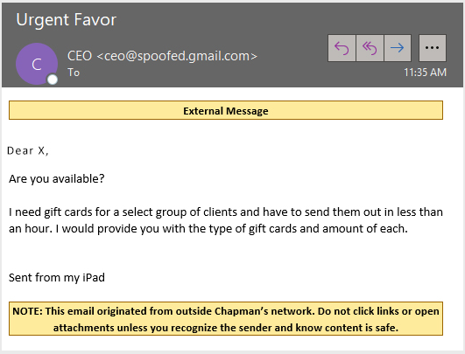
Types of Phishing
Spear phishing (aka CEO/CFO Fraud)
16

Slide 17
How to spot phishing
Watch for sender’s email address. Do not rely on the display name of sender
It’s asking you to do something that person or company has never asked you to do before
If there are any unusual requests made to you via email, it may be better to place a call to the sender to verify
Do not provide sensitive personal information over email
Tries to create a sense of urgency. Always gives yourself a time to process before responding.
Do not open any attachments or click any links from senders that you do not recognize. Phishing can disguise into many forms and some of them can be an ordinary WORD or EXCEL document.
If in doubt, please contact IT immediately without opening any links or attachments
17

Slide 18

Mobile Security
Mobile phone is a rich source of data
Yee Hong data may be on it
For you own protection
  Don’t download apps you don’t know
  Don’t use it for sensitive transactions
  Turn password protection on
  Be smart with what you share on social media
  Don’t loan your phone to anybody
Image source : rawpixel.com
18

Slide 19

Some Practical Ideas for Protecting Privacy
Consider why you need to collect and share resident/client information
Only access staff and resident data that you need to do your job
Don’t leave files out on desks or meeting rooms
Lock files in cabinets at night
19
Notes:
19

Slide 20
More Ideas
20
Do not copy staff and resident information unnecessarily or without authorization
Shred resident, applicant, and staff information before discarding. Clear papers from machines quickly
Double-check destination fax numbers
Keep staff, resident and applicant discussions out of hallways, elevators, and other public places
Be aware of who can hear you when on the phone

Slide 21
More Ideas
Lock or log off your computer when you step away
Change your computer password when prompted and keep it to yourself only
Avoid sending personal health information via e-mail
Be careful when you send or reply to emails making sure the correct recipients or email distribution groups are used
Do not store resident/client or confidential corporate information on your computer’s local hard drive or in a portable storage device (USB drives, portable hardware drives)
21
Notes:
21

Slide 22
Remember ….
Privacy and information security are everyone’s responsibility
Privacy or data breaches have serious ramifications
Be careful with suspicious emails
Be aware of vishing (telephone scams)
Be mindful of confidentiality and integrity of data
Follow Yee Hong company policies
Report privacy or information security concerns to your immediate supervisor or the Corporate Privacy Officer (Mike Cheng ext. 1178)
Privacy and Info Security - We’re all responsible!
22

